Slide 1
EDUC 200C Section 9 ANOVA
November 30, 2012

Slide 2
Goals
One-way ANOVA
Least Significant Difference (LSD)
Practice Problem
Questions?

Slide 3
Why use ANOVA?
We’re good at comparing the means of one or two groups—what happens if we have more?
Test pair-wise difference of all means?
No—we know eventually we’ll make a Type I error
Why??

Slide 4
What ANOVA does
ANOVA allows us to test whether multiple means are equal
H₀: μ₁= μ₂= μ₃=…= μ_{n}
Compares the variation in group means to the variation we think occurs because of sampling error
More formally, a comparison of variation between groups to the variation within groups

Slide 5
Between vs. within
Between group variation
Description of the spread of group means
The variation of the means between groups
Calculated in reference to the “grand mean”—the mean of all of the data combined
Within group variation
Description of the spread of observations within a group
Calculated in reference to each group’s own mean

Slide 6
The components of ANOVA
Sums of Squares (SS)
Degrees of freedom (df)
Mean Squares (MS)
F-statistic (F)
Effect size (ω²)

Slide 7
1. Sum of Squares (SS)

Slide 8
2. Degrees of freedom (df)
df_{B}=k-1
df_{W}=N-k

Slide 9
3. Mean Squares (MS)

Slide 10
4. F statistic

Slide 11
Interpreting the F statistic
F equals 1
Implies that the between- and within-group variability are equal
F greater than 1
Implies that variability between groups is larger than variability within groups
F between 0 and 1
Implies that variability between groups is smaller than the variability within groups
F negative
Not possible! The numerator and the denominator are both measures of spread, and these can never be negative

Slide 12
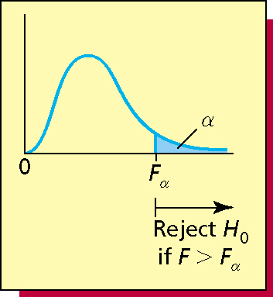
The F distribution
The F-distribution is always greater than 0 with the “hump” at 1.
It depends on respective degrees of freedom (df_{B} and df_{W})
The larger the F-statistic, the more we believe the groups are statistically different from one another

Slide 13
5. Effect Size (ω²)

Slide 14
You rejected H₀, now what?
Recall that our null hypothesis is:
H₀: μ₁= μ₂= μ₃=…= μ_{n}
Rejecting this means simply that not all means are equal
This gives you warrant to start doing t tests
But this is a pain…

Slide 15
Least Significant Difference (LSD)
You can calculate a “critical value” for the difference between means—any difference between means that exceeds this will be significant
Note: need groups of equal size
Where t_{α} is the critical value for a two tailed test with df=N-k, and n is the size of the groups

Slide 16
Practice Problem
The following are creativity test scores from a study examining the link between age and creativity
What is the null hypothesis?
Find F and compare to the appropriate critical F score for this study. Do we reject the null hypothesis?
Perform appropriate post hoc comparisons
Age 4 | Age 6 | Age 8 | Age 10
3 | 9 | 9 | 7
5 | 11 | 12 | 7
7 | 14 | 9 | 6
4 | 10 | 8 | 4
3 | 10 | 9 | 5

Slide 17
QUESTIONS?

